Slide 1
Lab4 - Image Scaling
班級：電子三乙
學號：106360210
姓名：劉紹祥

Slide 2
Contents
Method description
Input images
Output images
Source codes
Enlarged ones
Crop Enlarged ones
Reduced ones

Slide 3
Method description

Slide 4
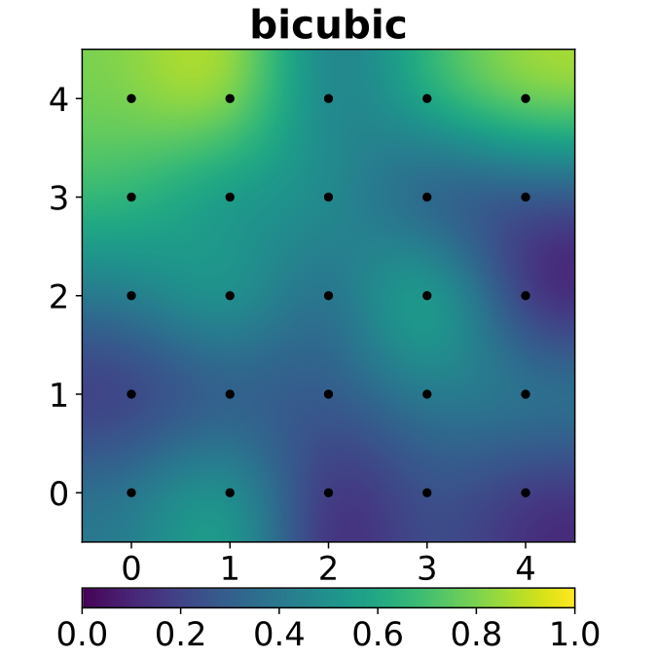
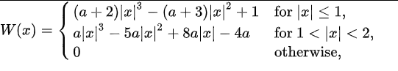
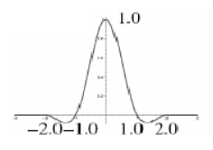
Bicubic Interpolation
Bicubic spline interpolation requires the solution of the linear system described above for each grid cell. An interpolator with similar properties can be obtained by applying a convolution with the following kernel in both dimensions:
Bicubic interpolation on the square
[0,4] X [0,4] consisting of 25 unit squares patched together. Bicubic interpolation as per Matplotlib's implementation.
Color indicates function value. The black dots are the locations of the prescribed data being interpolated.
Note how the color samples are not radially symmetric.

Slide 5
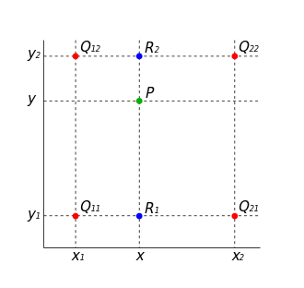
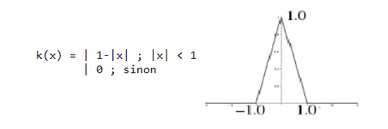
Nearest Neighbor Resampling
Bilinear sampling considers the closest 2x2 neighborhood of known pixel values surrounding the unknown pixel. It can be implemented by the triangle kernel k(x):
The four red dots show the data points and the green dot is the point at which we want to interpolate.

Slide 6
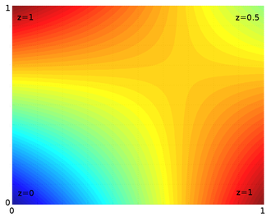
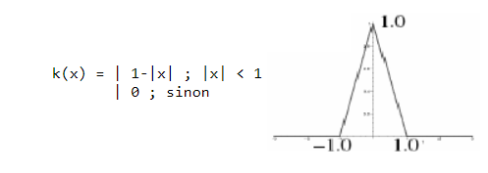
Bilinear Resampling
Bilinear sampling considers the closest 2x2 neighborhood of known pixel values surrounding the unknown pixel. It can be implemented by the triangle kernel k(x):
Example of bilinear interpolation on the unit square with the z values 0, 1, 1 and 0.5 as indicated. Interpolated values in between represented by color.

Slide 7
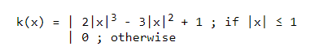
Hermite Resampling
Hermite resampling uses a convolution kernel to interpolate the pixels of the input image in order to calculate the pixel values of the output image. Hermite is a particular case of the bicubic algorithm, where a=0. The Hermite convolution kernel k(x) is defined as:

Slide 8
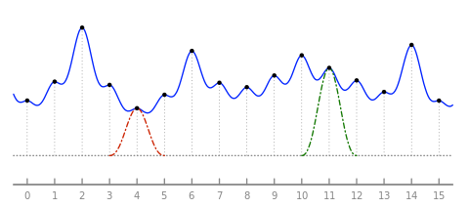
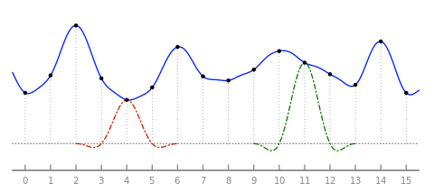
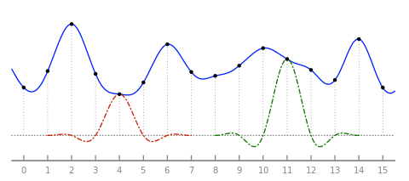
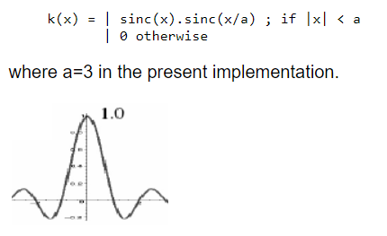
Lanczos Resampling
Lanczos resampling uses a convolution kernel to interpolate the pixels of the input image in order to calculate the pixel values of the output image. The Lanczos convolution kernel k(x) is defined as:
Partial plot of a discrete signal (black dots) and of its Lanczos interpolation (solid blue curve), with size parameter a equal to 1 (top), 2 (middle) and 3 (bottom). Also shown are two copies of the Lanczos kernel, shifted and scaled, corresponding to samples 4 and 11 (dashed curves).

Slide 9
Input images

Slide 10
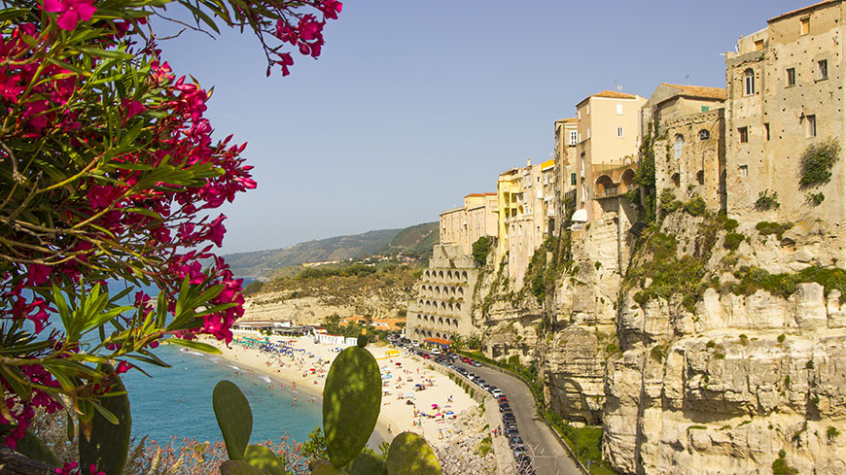
Size 870px X 489px

Slide 11
Output images

Slide 12
Reduced to 1/9

Slide 13

Original one versus Reduced one
Original size : 870px X 489px
Output size : 97px X 55px

Slide 14
Enlarged 4 times

Slide 15
Bicubic Interpolation

Slide 16

870px X 489px ➔ 3480px X 1956px
B

Slide 17

Crop 1000px X 1000px

Slide 18
Nearest Neighbor Interpolation

Slide 19

870px X 489px ➔ 3480px X 1956px

Slide 20
Crop 1000px X 1000px

Slide 21
Bilinear Interpolation

Slide 22

870px X 489px ➔ 3480px X 1956px

Slide 23
Crop 1000px X 1000px

Slide 24
Hermite Interpolation

Slide 25

870px X 489px ➔ 3480px X 1956px

Slide 26
Crop 1000px X 1000px

Slide 27
Lanczos Interpolation

Slide 28

870px X 489px ➔ 3480px X 1956px

Slide 29
Crop 1000px X 1000px

Slide 30
Source Codes

Slide 31
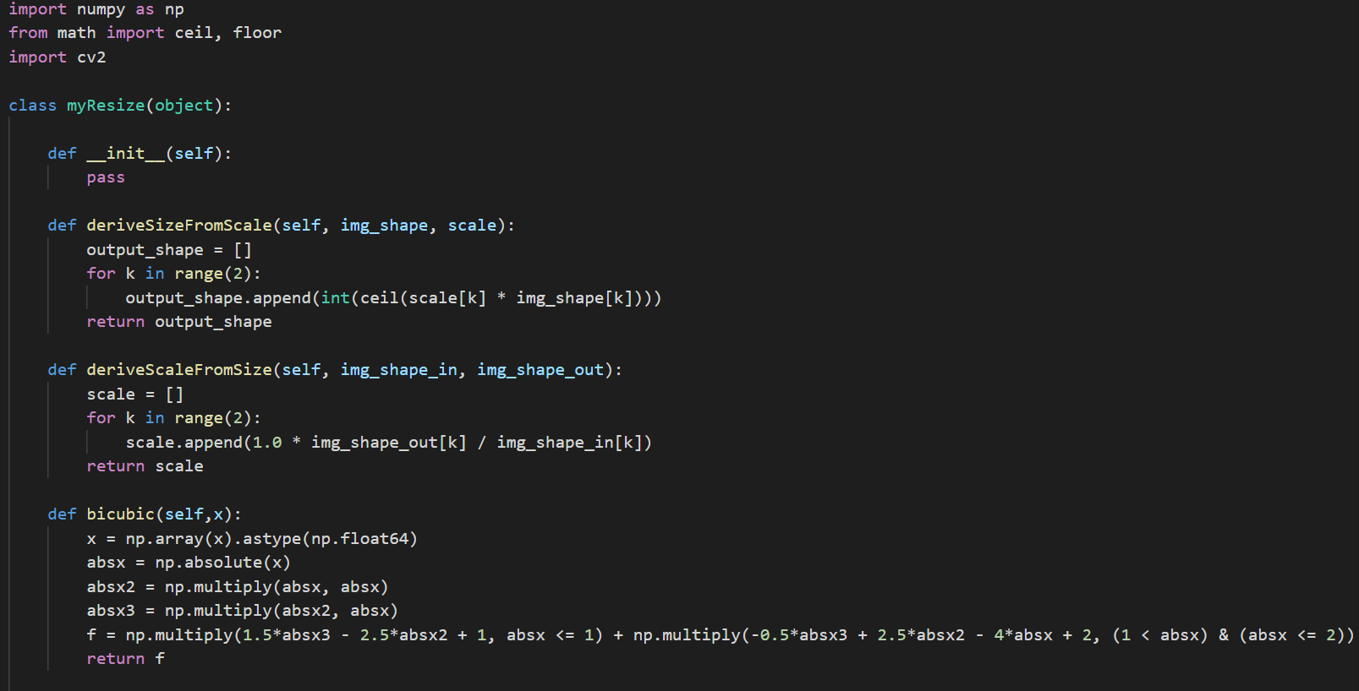

Slide 32
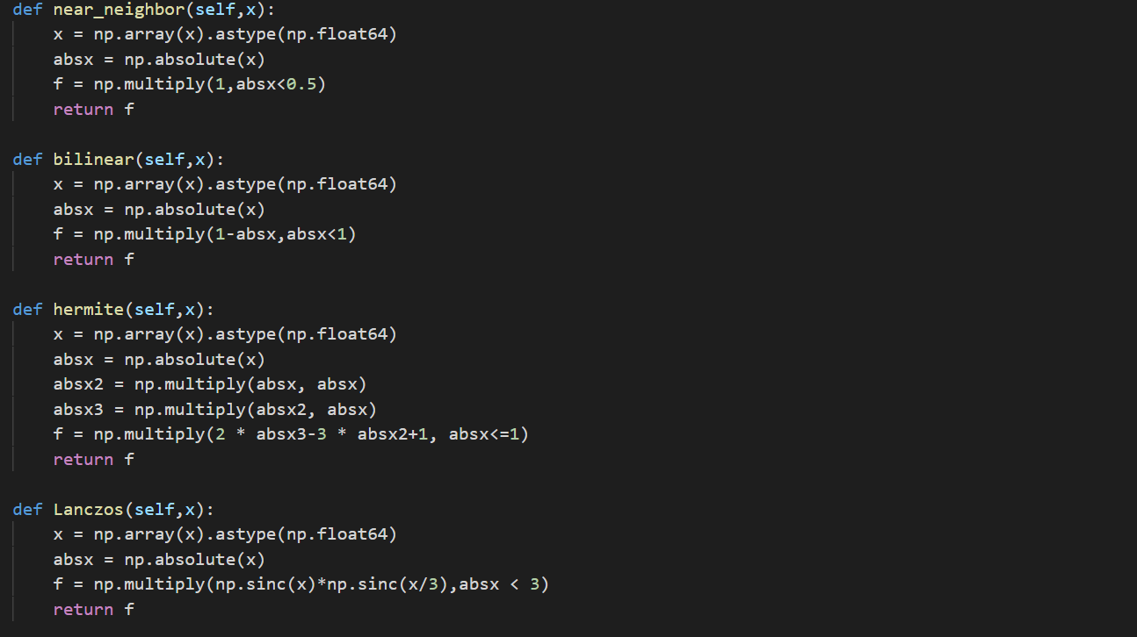

Slide 33
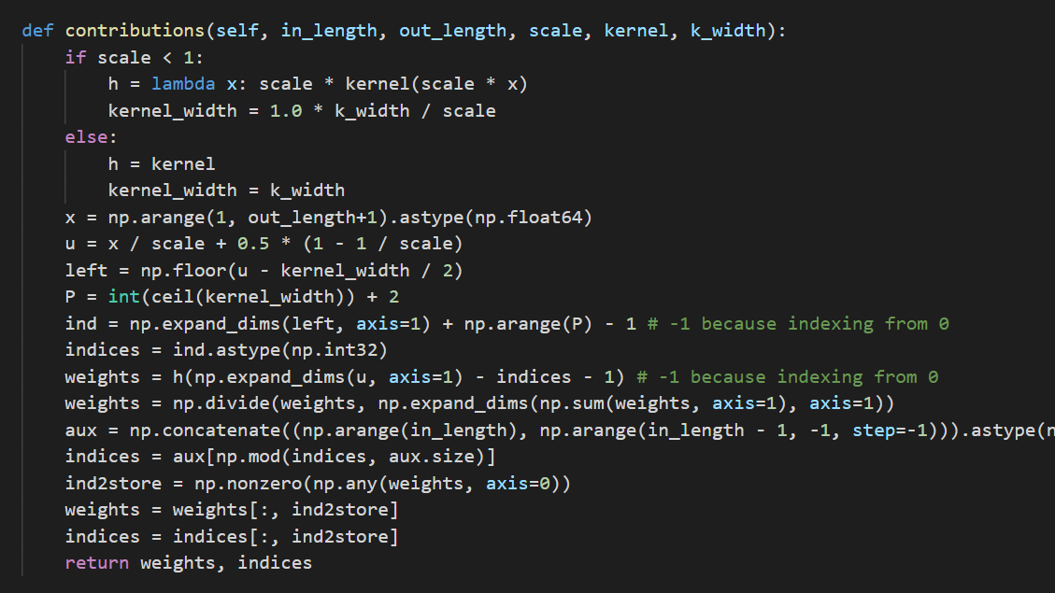

Slide 34
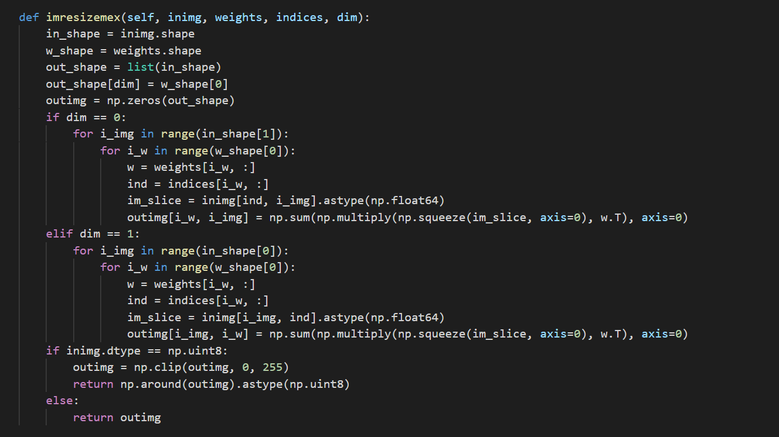

Slide 35
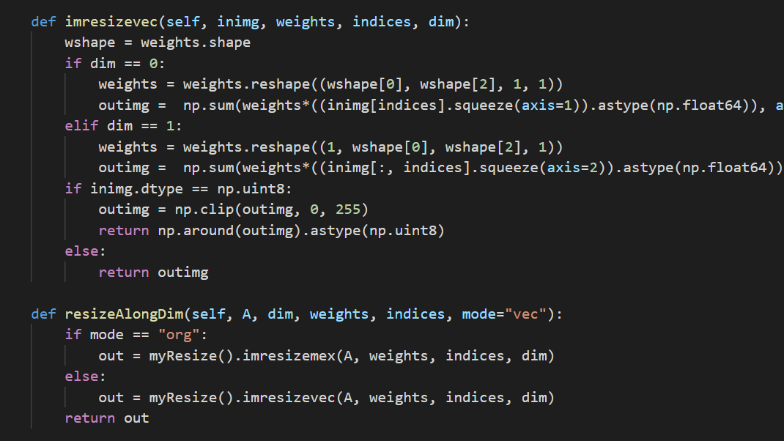

Slide 36
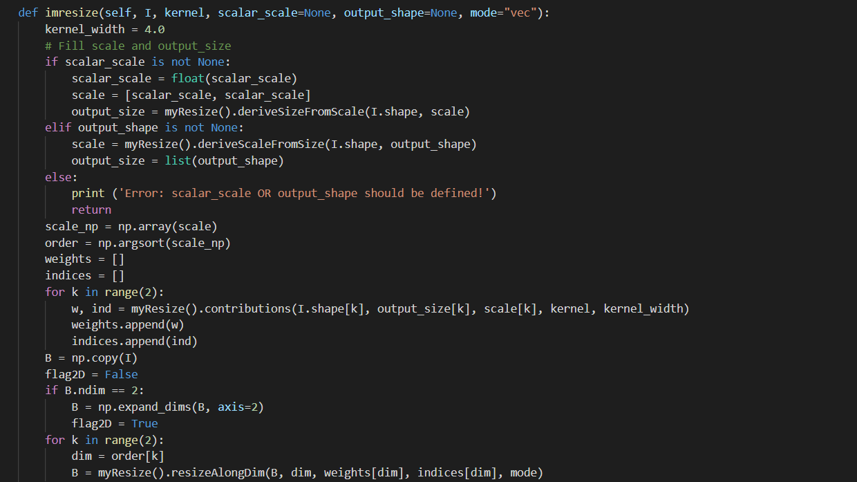

Slide 37
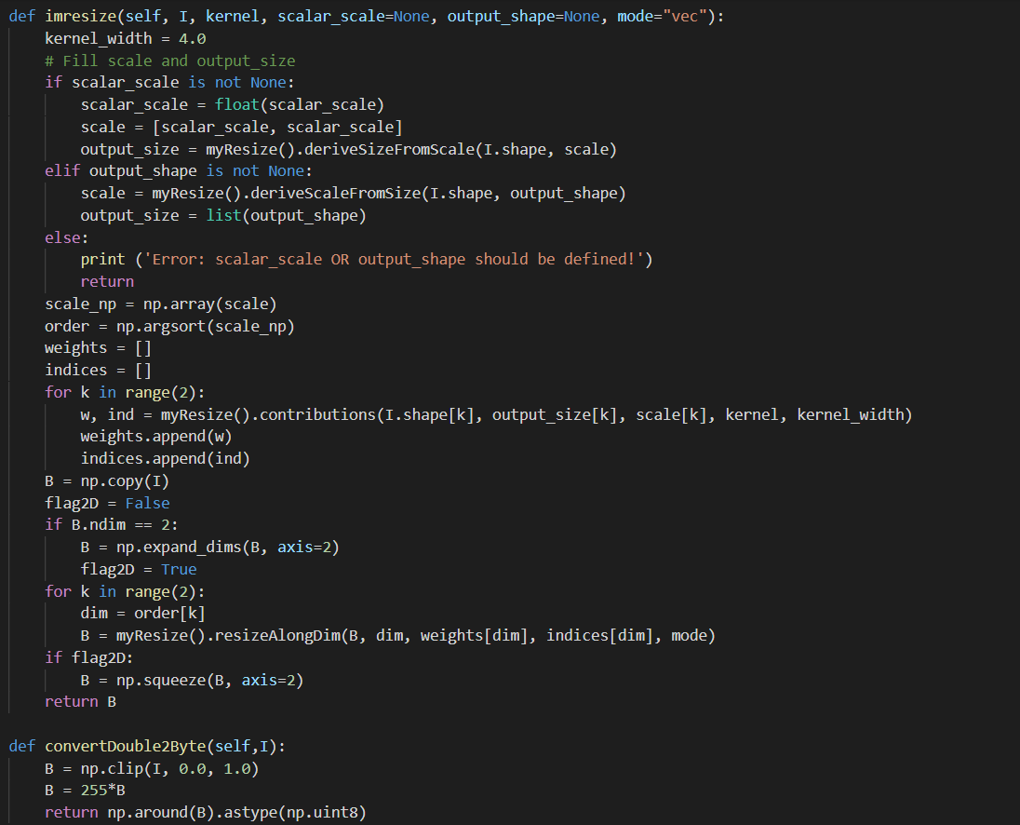

Slide 38
